Slide 1
Lesson: Core JAVA
Basic to Advanced topics

Slide 2
CORE JAVA TOPICS
Collection-List, Set, Map
Constructor
Acces Specifier
Access Modifier
Variables and types
Exception Handling
User Defined Exception
Encapsulation
Core Java Interview Questions and Answers
Core Java Interview programs
Introduction of Java
OOPs, Class, Object, Method
Inheritance
Data types and Return types
Polymorphism
Scanner Class
Abstraction and Interface
Control Statements
Looping
String and Types
Array

Slide 3

JAVA INTRODUCTION
Java developed by Sun Microsystems (1995), led by the team of James Gosling.
Now It is owned by Oracle, and more than 3 billion devices run Java.
It is used for mobile applications, desktop, web application, web servers and games, DB and much more.
Java is a simple programming Language
Writing, Compilation and Debugging a program is very easy in Java.
It helps to create reusable code
Java is one of the most Readable Language
Java has more features………

Slide 4
JAVA MAIN FEATURES
1. Platform Independent
-During Compilation java Converts into byte code
-Using bytecode we can run the application to any platform such as windows, mac, Linux etc.
2. Open Source
-A program which source code is available to public for use and/or modification at free of cost
3. Multithreading
-Java enables a program to perform several task simultaneously
4. More Secure
-It provides the virtual firewall between the application and the computer
-So it is doesn’t grant any unauthorized access
5. Portable
-WORA -Write Once Run Anywhere
-Java code written in one machine can run on another machine

Slide 5
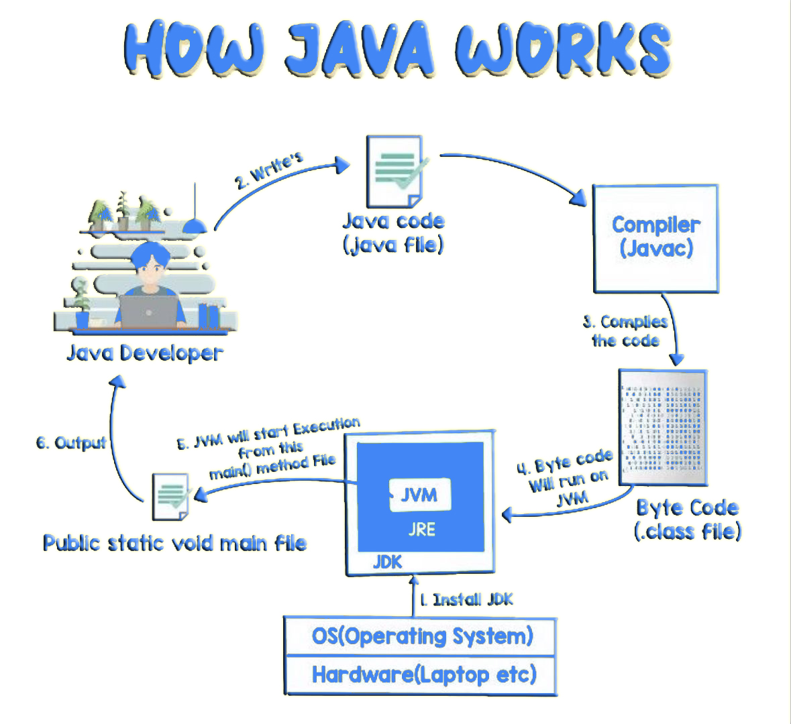
HOW JAVA WORKS

Slide 6
JDK vs JRE vs JVM
JDK
JRE
Java Compiler
+
Other
Development
Tools
JVM
+
+
Library Files

Slide 7
Continue…..
JDK : Java Development Kit
If we want to run or develop a program in java JDK is essential
It provide everything needed to write compile and debug java progrms
JDK versions: 1.0 to 1.9
Mostly V1.8 is used now
JRE : Java Runtime Environment
It is a set of software tools which are used for developing Java applications.
It is used to provide the runtime Environment
It contains a set of libraries + other files that JVM uses at runtime.
JVM : Java Virtual Machine
It is called a virtual machine because it doesn't physically exist.
It is mainly used allocate the memory and compiling
A JVM is a Specification, Implementation and Runtime Instance

Slide 8
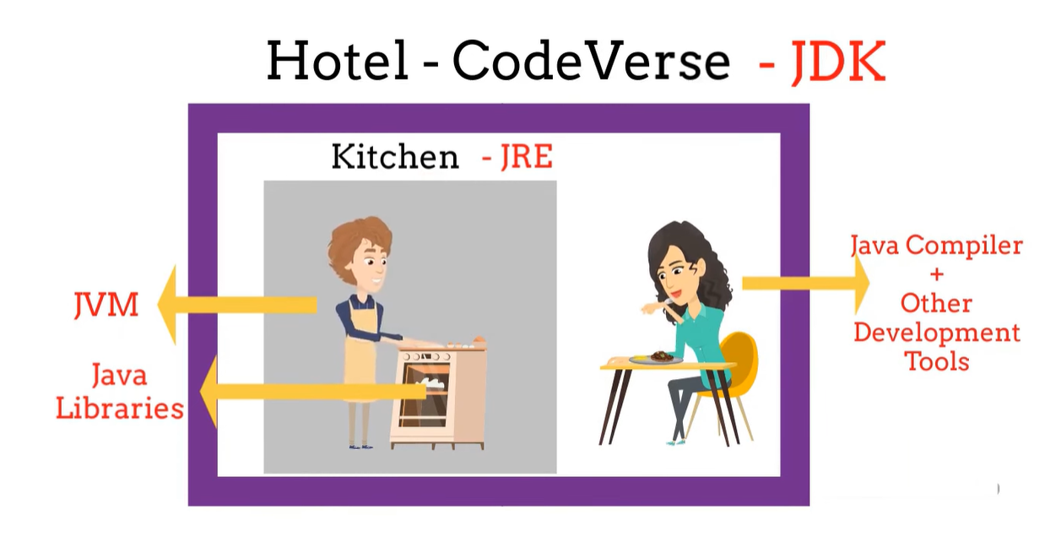
Example

Slide 9
Tools and Java Configuation Setup
Tools:
Notepad
Net beans
Eclipse (Juno, Kepler, Luna, Mars)
J Developer-Oracle
RAD-IBM
Java Configuration Setup
JDK download
Install JDK
Verify JDK
Download Eclipse as Zip
[URL: https://www.eclipse.org/downloads/packages]
Extract and launch workspace

Slide 10
Standard Notation or Naming Standards
Pascal Notation:
Each word of first letter should be capital
Example: FacebookTechnolgyLimited
Followed in project name, class name
Camel Notation
First word of first letter should be small remaining each word of first letter should be capital.
Example: facebookTechnolgyLimited
Followed in object name, method name, variable name

Slide 11
Thank You!! We will Continue with OOPs

